Slide 1
Lecture 3
Graphical Methods for Describing Data
Displaying Categorical Data
Ref: Introduction to Statistics and Data Analysis
The Practice of Statistics

Slide 2
Data Analysis: Making Sense of Data
DISPLAY categorical data with a bar graph
IDENTIFY what makes soe graphs of categorical data deceptive
CALCULATE and DISPLAY the marginal distribution of a categorical variable from a two-way table
CALCULATE and DISPLAY the conditional distribution of a categorical variable for a particular value of the other categorical variable in a two-way table
DESCRIBE the association between two categorical variables

Slide 3
How to display categorical variables?
Frequency tables can be difficult to read.
Sometimes it is easier to analyze a distribution by displaying it with a bar graph or pie chart.

Slide 4
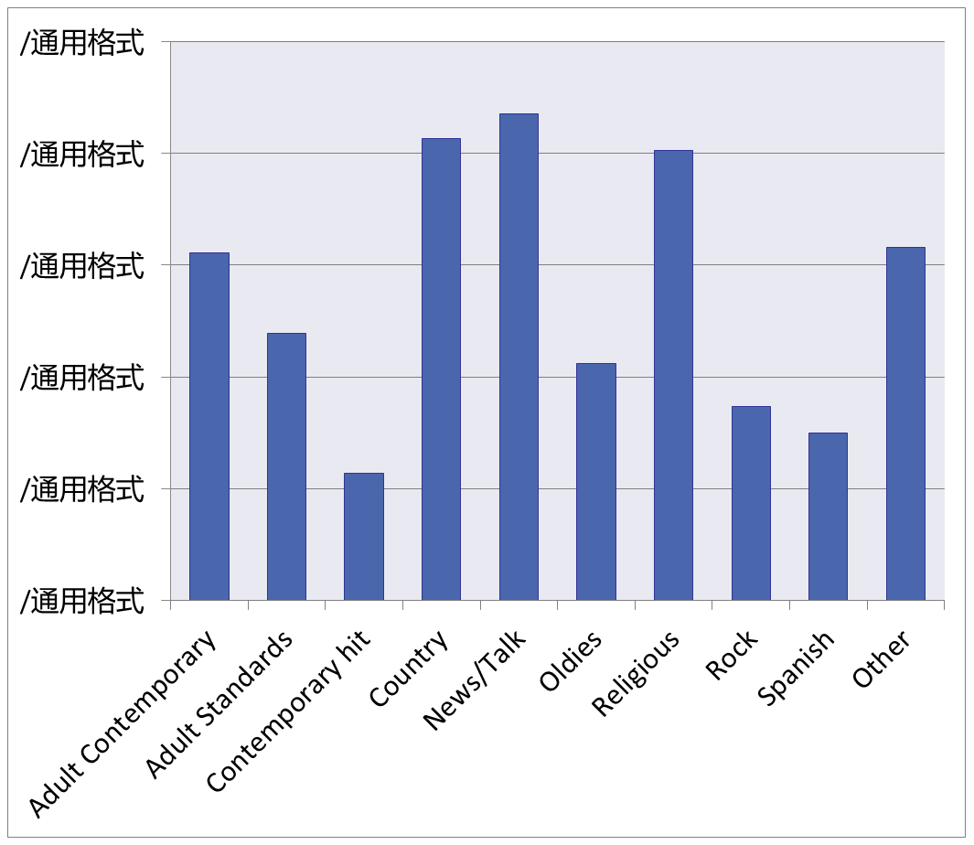
Bar Graph
Bar graphs compare several quantities by comparing the heights of bars that represent those quantities. Our eyes, however, react to the area of the bars as well as to their height.
When you draw a bar graph, make the bars equally wide.
Frequency Table
Format | Count of Stations
Adult Contemporary | 1556
Adult Standards | 1196
Contemporary Hit | 569
Country | 2066
News/Talk | 2179
Oldies | 1060
Religious | 2014
Rock | 869
Spanish Language | 750
Other Formats | 1579
Total | 13838

Slide 5
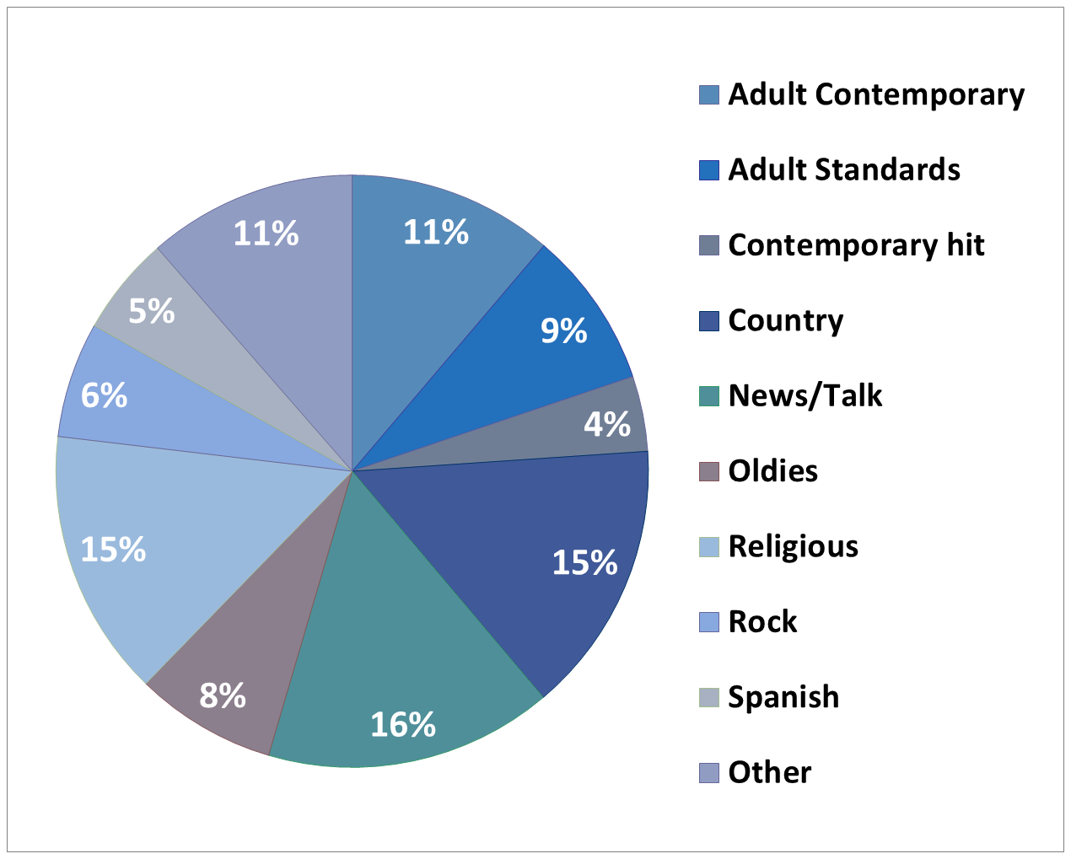
Pie Chart
Relative Frequency Table
Format | Percent of Stations
Adult Contemporary | 11.2
Adult Standards | 8.6
Contemporary Hit | 4.1
Country | 14.9
News/Talk | 15.7
Oldies | 7.7
Religious | 14.6
Rock | 6.3
Spanish Language | 5.4
Other Formats | 11.4
Total | 99.9

Slide 6
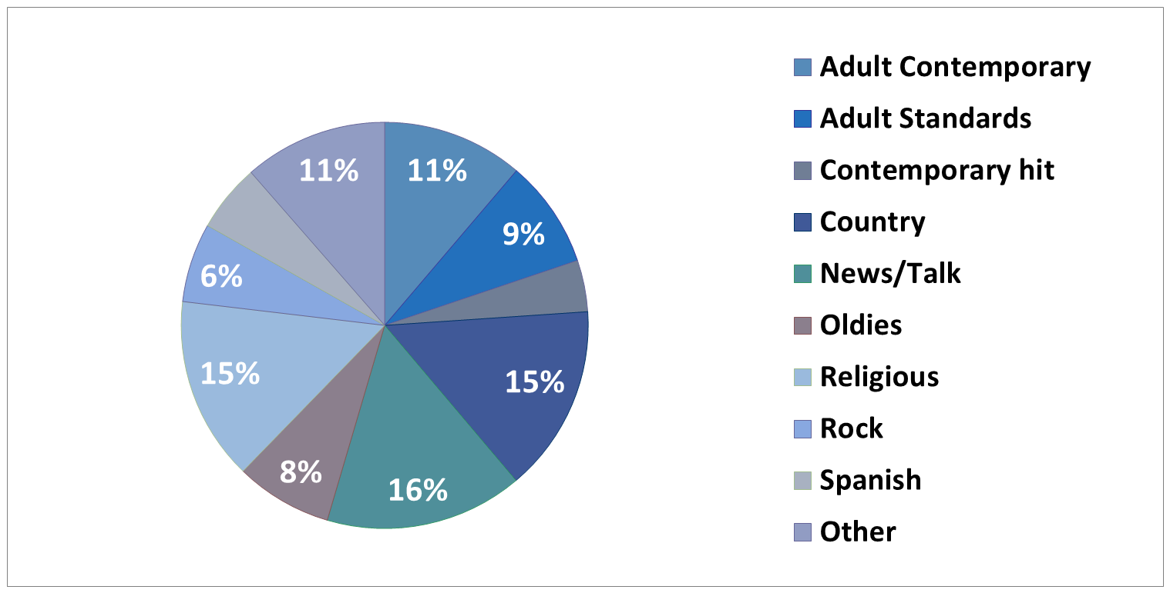
Note that a pie chart must include all categories that make up a whole, which might mean adding an “other” category, as in the left sample.

Slide 7
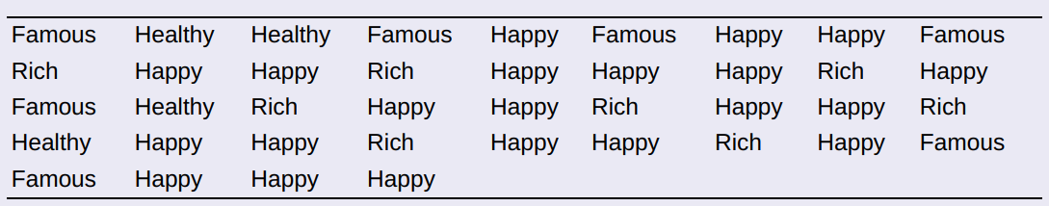
Check your understanding
The American Statistical Association sponsors a web-based project that collects data about primary and secondary school students using surveys. We used the site’s “Random Sampler” to choose 40 U.S. high school students who completed the survey in a recent year.
One of the questions asked:
Which would you prefer to be? Select one.
________Rich ________Happy ________Famous ________Healthy
Here are the responses from the 40 randomly selected students:
Make a relative frequency bar graph of the data.

Slide 8
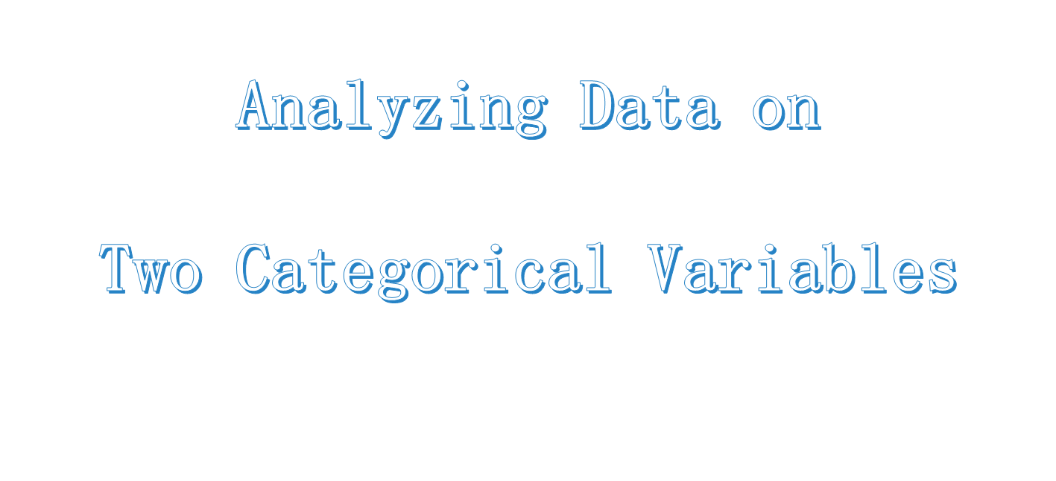

Slide 9
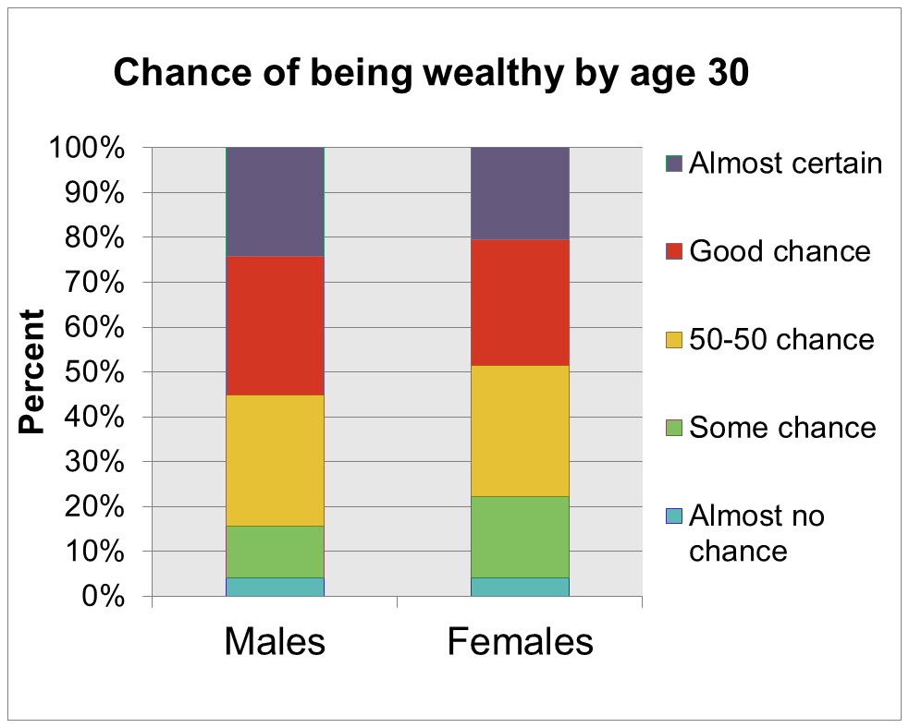
Response | Male
Almost no chance | 4.0%
Some chance | 11.6%
A 50-50 chance | 29.3%
A good chance | 30.8%
Almost certain | 24.3%
Female
4.1%
18.0%
29.4%
28.0%
20.5%
How to examine or compare conditional distributions:
Select the row(s) or column(s) of interest.
Use the data in the table to calculate the conditional distribution (in percents) of the row(s) or column(s).
Make a graph to display the conditional distribution. Use a side-by-side bar graph or segmented bar graph to compare distributions.

Slide 10
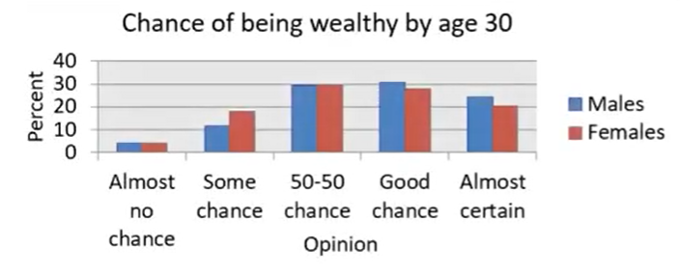
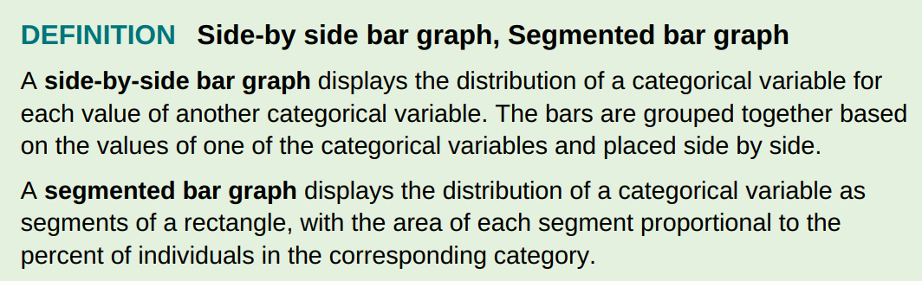

Slide 11
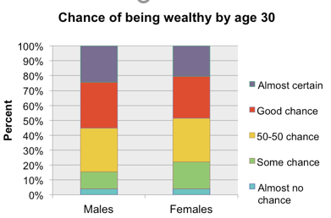
Relationships Between Categorical Variables

Slide 12
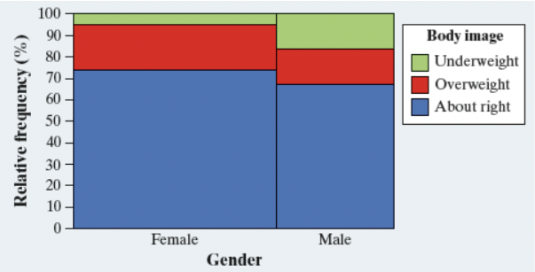
MOSAIC PLOTS
A mosaic plot is a modified segmented bar graph in which the width of each rectangle is proportional to the number of individuals in the corresponding category.

